Slide 1
Is the modern NBA more selfish today than ever before?
Aaron Kuethe
DSC 530 Final Project

Slide 2
Goal
My goal is to establish if there is any truth to the theories that the “no one plays team basketball” and “no one plays defense in the NBA”. Essentially, it boils down to “is the modern NBA more selfish than before?”
This can seem like a loaded question or difficult to answer, but I believe a few variables can help to identify the theories around “team basketball” and “playing defense”.
If points are increasing by year and assists are decreasing, it can be inferred that players are scoring more on their own and not passing.
If steals, turnovers, and blocks are decreasing, it can be inferred that defense isn’t being played as much as it used to.

Slide 3
Variables Identified to have an Impact
PTS – points scored, when a player shoots the ball into the hoop
AST – assists made, when one player passes the ball to another and their teammate scores
STL – steals recorded when a player takes the ball from an opponent
BLK – blocks of an opponent’s shot
TOV – turnovers when the player throws the ball out of bounds, commits an offensive foul or loses the ball to the opponent
PF – fouls committed on the opposing team’s players
FTA – free throws attempted
FT – free throws made

Slide 4
EDA Discoveries
ISSUES
Steals and blocks didn’t become official stats until 1974.
Turnovers weren’t an official stat until 1978.
There were 2 lockouts in NBA history where 82 games were not played in a season.
The dataset had duplicate records for a player if they played for multiple teams in the same year.
SOLUTION
Created filters to account for these issues that had arisen.
All of these were taken into consideration ahead of time thanks to EDA.

Slide 5
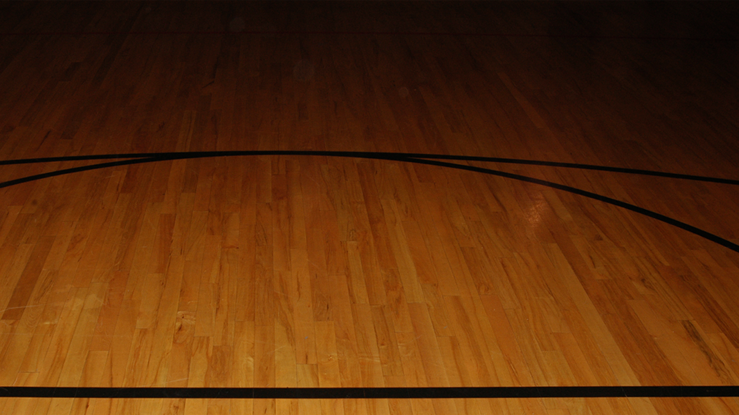
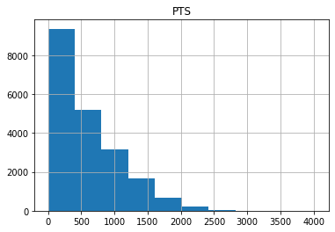
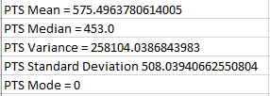
Points (PTS) Histogram

Slide 6
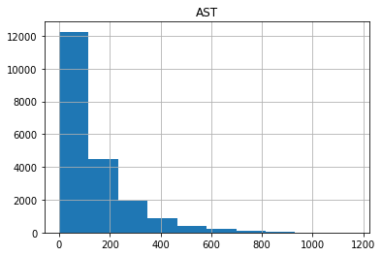
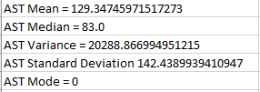
Assists (AST) Histogram

Slide 7
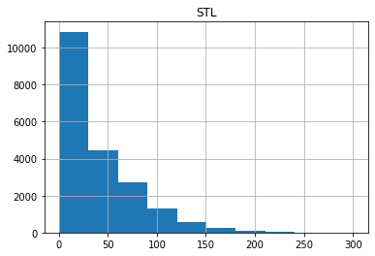
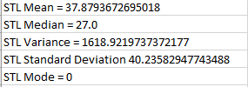
Steals (STL) Histogram

Slide 8
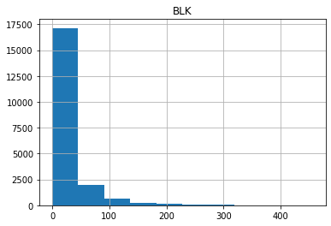
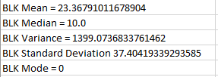
Blocks (BLK) Histogram

Slide 9
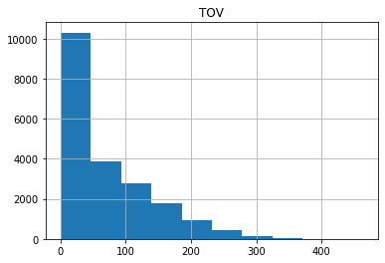
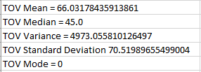
Turnovers (TOV) Histogram

Slide 10
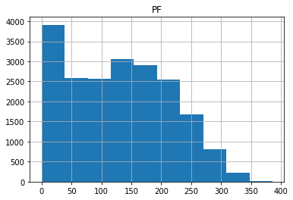
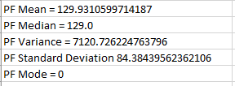
Personal Fouls (PF) Histogram

Slide 11
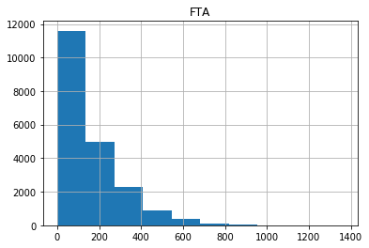
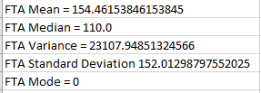
Free Throws Attempted (FTA) Histogram

Slide 12
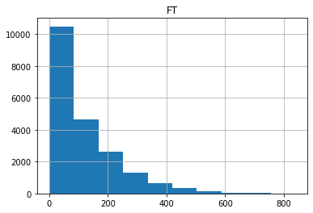
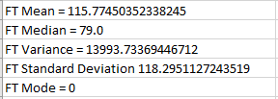
Free Throws Made (FT) Histogram

Slide 13
Histogram Recap
Almost every histogram was right skewed, specifically J-shaped. This means there are a lot of values at 0 and it decreases from there as the value increases
This was somewhat expected, as every player starts out with 0 in a basketball game and must accrue statistics. There is a finite amount of stats to be accrued since every game has a time limit. Therefore it is logical to conclude that a lot of people have accrued very little stats, while only a few players would have accrued a lot.

Slide 14
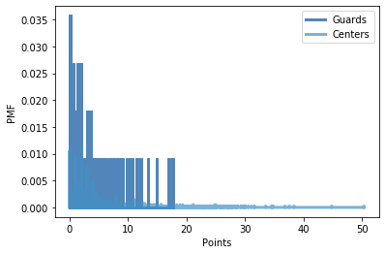
PMF of Points – Guards vs Centers
Centers have a higher probability to average more points a game than guards do, however, there are less centers than guards.
This would suggest that centers might be harder to find, but if your team has an elite center, they can be unstoppable.
In recent years, there has been a shift towards guards being more capable of scoring, so I wonder if that trend would show their pmf to be higher in more recent history.

Slide 15
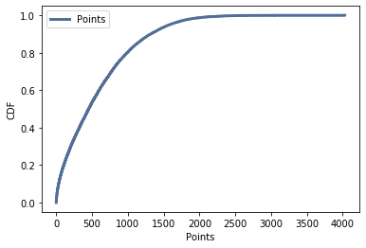
CDF of Points
This shows the distribution of player's points.The points CDF shows a tremendous jump off the start. It appears that over 80% of the players have seasons where they scored less than 1000 points. Then the line starts to trail off, meaning there were fewer and fewer players that had high scoring seasons.

Slide 16
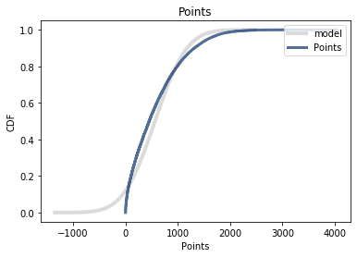
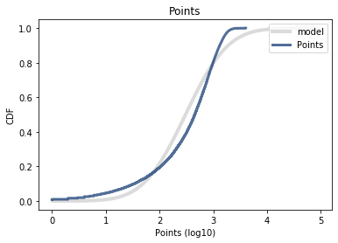
Normal vs Lognormal Distribution
At first, I tried using normal distribution, but it did not exactly fit.
Lognormal appeared to fit the model a little better, although not perfect by any means.

Slide 17
Pareto Distribution Considered for Points
Pareto distribution is used for uneven, heavily skewed distributions, such as points.
The xmin has to be greater than 0, but someone could have 0 points. Either it can’t be used in this scenario, or I was doing it incorrectly.
Pareto might have been the way to ultimately go, but I could not figure it out.

Slide 18
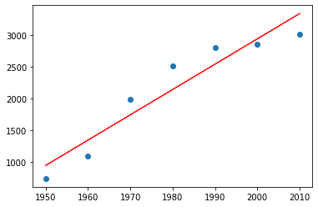
Scatterplot of Average Points in a Decade from 1950-2017
Pearson's correlation is 0.9498, which is high and suggests a strong linear relationship.
Spearman's correlation is 1.0, which is high and suggests a strong linear relationship.
The covariance is 15975.78, which is high and suggests a strong relationship.
It appears true that more points are being scored as time goes on.

Slide 19
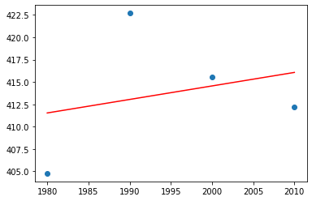
Scatterplot of Average Assists in a Decade from 1980-2017
Pearson's correlation is 0.263, which means there is not a strong correlation.
Spearman's correlation is 0.2, which means there is not a strong correlation.
The covariance is 18.91, which isn't too high, so there might not be a strong relationship.
The fact that assists aren't increasing as years go on, may lead to the theory that players are more selfish, especially with the slight dip over the last few decades. Howerver, it doesn't exactly prove this.

Slide 20
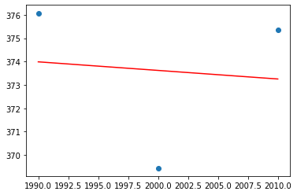
Scatterplot of Steals + Blocks from 1990-2017
Pearson's correlation is -0.10, which means there is not a strong correlation.
Spearman's correlation is -0.5, which means there is negative correlation of decent strength.
The covariance is -2.45, which isn't too high, so there might not be a strong relationship.
Stats show a declining trend line over the last 3 decades, which can at least rule out that more defense is being played than before.

Slide 21
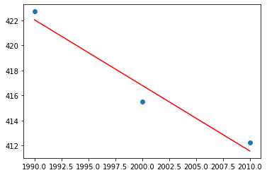
Scatterplot of Turnovers
It does appear that there is a strong negative Peasron's correlation and Spearman's correlation, of -0.978 and -1.0, respectively.
The covariance is -34.91, which is decently negative.
If turnovers are going down in the last 30 years, it could mean one of two things, either players are taking better care of the ball, or teams aren't playing as much defense and therefore not forcing turnovers.
Combined with the slight decline in steals and blocks, this lends itself to the narrative that there is less defense played than in prior years.

Slide 22
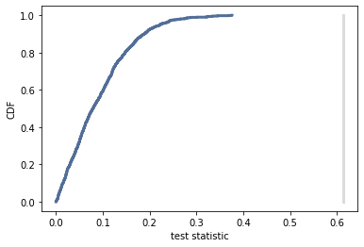
Hypothesis Test – Is scoring up this decade?
Is scoring up this decade?
Is scoring up this decade?
Not sure my data was conducive for a hypothesis test, and the left graph is the best I could produce.
P-value = 0.0
Actual = 0.613
MaxTestStat = 0.376
0.0
0.6125476885940486 0.3758995438442767

Slide 23
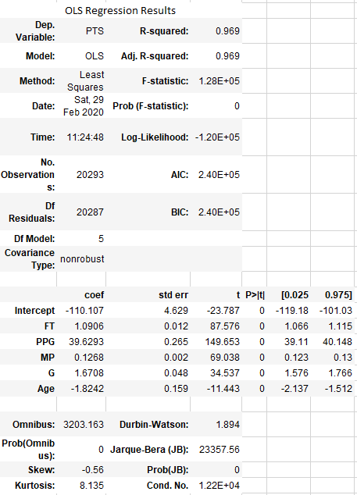
Regression Analysis
> year_model = smf.ols('PTS ~ FT + PPG + MP + G’, data = filtered_data)
> results = year_model.fit()
> results.summary()
This was the highest R-squared value that I could produce.
I tried filtering from 1980-2017, but that only raised the value from 0.969 to 0.970.
It makes sense that free throws made, points per game, minutes played, and games played all had an impact on points scored, which is why I was able to produce a high R-squared value.

Slide 24
Conclusion
I thought the scatter plots were more telling than anything else throughout this project when trying to prove if NBA players are more selfish in the modern era. Points seem to be increasing, with steals, blocks, and turnovers all trending downwards. Having said that, it wasn’t a clear-cut answer, it just helps that narrative.
After going through this whole process, it seemed like my dataset was not the best for what we were trying to do. I think that is a major takeaway from this project for me. Even in the workplace, we might not have the perfect dataset that we need to manipulate to look at, and even then, it might not help to answer the questions we are looking for.

Slide 25
Citations
Data:
Goldstein, O. (2018, April 27). NBA Players stats since 1950. Retrieved from https://www.kaggle.com/drgilermo/nba-players-stats#Seasons_Stats.csv
Other Sources:
Downey, A. (2015). Think Stats (2nd ed.). Sebastopol, CA: OReilly Media.
Sorensen, M. (2019, February 21). NBA rules have adapted over the years to make the game more fun for players, fans. Retrieved from https://www.deseret.com/2019/2/21/20666425/nba-rules-have-adapted-over-the-years-to-make-the-game-more-fun-for-players-fans

